Slide 1

SQL DESIGN AND IMPLEMENTATION
Notes:
Frequently, presenters must deliver material of a technical nature to an audience unfamiliar with the topic or vocabulary. The material may be complex or heavy with detail. To present technical material effectively, use the following guidelines from Dale Carnegie Training®.
Consider the amount of time available and prepare to organize your material. Narrow your topic. Divide your presentation into clear segments. Follow a logical progression. Maintain your focus throughout. Close the presentation with a summary, repetition of the key steps, or a logical conclusion.
Keep your audience in mind at all times. For example, be sure data is clear and information is relevant. Keep the level of detail and vocabulary appropriate for the audience. Use visuals to support key points or steps. Keep alert to the needs of your listeners, and you will have a more receptive audience.

Slide 2
An Overview of SQL
SQL stands for Structured Query Language.
It is the most commonly used relational database language today.
SQL works with a variety of different fourth-generation (4GL) programming languages
Notes:
In your opening, establish the relevancy of the topic to the audience. Give a brief preview of the presentation and establish value for the listeners. Take into account your audience’s interest and expertise in the topic when choosing your vocabulary, examples, and illustrations. Focus on the importance of the topic to your audience, and you will have more attentive listeners.

Slide 3
SQL is used for:
Data Manipulation
Data Definition
Data Administration
All operations are expressed as an SQL statement or command.
Notes:
If you have several points, steps, or key ideas use multiple slides. Determine if your audience is to understand a new idea, learn a process, or receive greater depth to a familiar concept. Back up each point with adequate explanation. As appropriate, supplement your presentation with technical support data in hard copy or on disc, e-mail, or the Internet. Develop each point adequately to communicate with your audience.

Slide 4
SQL Requirements
SQL Must be embedded in a programming language or a web page.
SQL is a free form language so there is no limit to the the number of words per line or fixed line break.
Syntax statements, words or phrases are always in lower case; keywords are in uppercase.
Not all versions are case sensitive!
Notes:
In your opening, establish the relevancy of the topic to the audience. Give a brief preview of the presentation and establish value for the listeners. Take into account your audience’s interest and expertise in the topic when choosing your vocabulary, examples, and illustrations. Focus on the importance of the topic to your audience, and you will have more attentive listeners.

Slide 5
SQL is a Relational Database
Represent all info in database as tables
Keep logical representation of data independent from its physical storage characteristics
Use one high-level language for structuring, querying, and changing info in the database
Support the main relational operations
Support alternate ways of looking at data in tables
Provide a method for differentiating between unknown values and nulls (zero or blank)
Support Mechanisms for integrity, authorization, transactions, and recovery
Notes:
If you have several points, steps, or key ideas use multiple slides. Determine if your audience is to understand a new idea, learn a process, or receive greater depth to a familiar concept. Back up each point with adequate explanation. As appropriate, supplement your presentation with technical support data in hard copy or on disc, e-mail, or the Internet. Develop each point adequately to communicate with your audience.

Slide 6
What Can SQL do?
SQL can execute queries against a database
SQL can retrieve data from a database
SQL can insert records in a database
SQL can update records in a database
SQL can delete records from a database
SQL can create new databases
SQL can create new tables in a database
SQL can create stored procedures in a database
SQL can create views in a database
SQL can set permissions on tables, procedures, and views

Slide 7
SQL DML and DDL
SQL can be divided into two parts: The Data Manipulation Language (DML) and the Data Definition Language (DDL).
The query and update commands form the DML part of SQL:
SELECT - extracts data from a database
UPDATE - updates data in a database
DELETE - deletes data from a database
INSERT INTO - inserts new data into a database

Slide 8
The most important DDL statements in SQL are:
• CREATE DATABASE - creates a new database
• ALTER DATABASE - modifies a database
• CREATE TABLE - creates a new table
• ALTER TABLE - modifies a table
• DROP TABLE - deletes a table
• CREATE INDEX - creates an index (search key)
• DROP INDEX - deletes an index

Slide 9
SQL CREATE TABLE Syntax
CREATE TABLE table_name
(
column_name1 data_type constraint if any,
column_name2 data_type constraint if any,
column_name3 data_type constraint if any,
....
);
CREATE TABLE Persons
(
P_Id int,
LastName varchar(255),
FirstName varchar(255),
Address varchar(255),
City varchar(255)
)

Slide 10
Specifying SQL Constraints
Constraints are used to limit the type of data that can go into table.
• NOT NULL
• UNIQUE
• PRIMARY KEY
• FOREIGN KEY
• CHECK
• DEFAULT

Slide 11
NOT NULL Constraints in SQL
NOT NULL : By default, a column can hold NULL. If you not want to allow NULL value in a column, you will want to place a constraint on this column.
CREATE TABLE Customer
(
SID integer NOT NULL,
Last_Name varchar (30) NOT NULL,
First_Name varchar(30)
);

Slide 12
UNIQUE
The UNIQUE constraint ensures that all values in a column are distinct.
CREATE TABLE Customer
(
SID integer Unique,
Last_Name varchar (30),
First_Name varchar(30)
);

Slide 13
SQL UNIQUE Constraint
The UNIQUE and PRIMARY KEY constraints both provide a guarantee for uniqueness for a column or set of columns.
A PRIMARY KEY constraint automatically has a UNIQUE constraint defined on it.
You can have many UNIQUE constraints per table, but only one PRIMARY KEY constraint per table.

Slide 14
CHECK
The CHECK constraint ensures that all values in a column satisfy certain conditions.
  CREATE TABLE Customer
  (
  SID integer CHECK (SID > 0),
  Last_Name varchar (30),
  First_Name varchar(30)
  );

Slide 15
Creating Primary key constraint
CREATE TABLE Persons (
P_Id int NOT NULL,
LastName varchar(255) NOT NULL,
FirstName varchar(255),
Address varchar(255),
City varchar(255),
CONSTRAINT pk_PersonID PRIMARY KEY (P_Id,LastName)
)

Slide 16
To DROP a PRIMARY KEY Constraint
ALTER TABLE Persons DROP PRIMARY KEY

Slide 17
Creating Foreign Key
A foreign key is a field (or fields) that points to the primary key of another table.
The purpose of the foreign key is to ensure referential integrity of the data.
CREATE TABLE ORDERS
(
Order_ID integer primary key,
Order_Date date,
Customer_SID integer references CUSTOMER(SID)
);

Slide 18
Naming the constraints
CREATE TABLE Persons
(
P_Id int NOT NULL,
LastName varchar(255) NOT NULL,
FirstName varchar(255),
Address varchar(255),
City varchar(255),
CONSTRAINT uc_PersonID UNIQUE (P_Id,LastName)
)

Slide 19
Using Alter
Altering Table
ALTER TABLE Persons
ADD PRIMARY KEY (P_Id)
Altering Constraints
ALTER TABLE Persons
ADD CONSTRAINT pk_PersonID PRIMARY KEY (P_Id,LastName)

Slide 20
SELECT… FROM… WHERE…
        SELECT <attribute list>
        FROM <table list>
        WHERE <condition>
<attribute list> is a list of attribute names
<table list> is a list of the relation names
<condition> is a conditional (Boolean) expression

Slide 21


Slide 22


Slide 23

Simple SQL Queries
Query 0: Retrieve the birthdate and address of the employee whose name is 'John B. Smith'.
  Q0: SELECT BDATE, ADDRESS
  FROM EMPLOYEE
  WHERE FNAME='John' AND MINIT='B’
  AND LNAME='Smith’
Slide 8-<number>

Slide 24
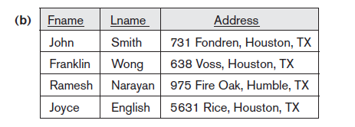
Simple SQL Queries (cont.)
Query 1: Retrieve the name and address of all employees who work for the 'Research' department.
  Q1: SELECT FNAME, LNAME, ADDRESS
  FROM EMPLOYEE, DEPARTMENT
  WHERE DNAME='Research' AND DNUMBER=DNO
  (DNAME='Research') is a selection condition (corresponds to a SELECT operation in relational algebra)
  (DNUMBER=DNO) is a join condition (corresponds to a JOIN operation in relational algebra)
Slide 8-<number>

Slide 25
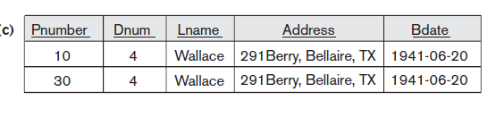
Simple SQL Queries (cont.)
Query 2: For every project located in 'Stafford', list the project number, the controlling department number, and the department manager's last name, address, and birthdate.
  Q2: SELECT PNUMBER, DNUM, LNAME, BDATE, ADDRESS
  FROM PROJECT, DEPARTMENT, EMPLOYEE
  WHERE DNUM=DNUMBER AND MGRSSN=SSN AND PLOCATION='Stafford'
  In Q2, there are two join conditions
  The join condition DNUM=DNUMBER relates a project to its controlling department
  The join condition MGRSSN=SSN relates the controlling department to the employee who manages that department
Slide 8-<number>

Slide 27
Aliases, * and DISTINCT, Empty WHERE-clause
In SQL, we can use the same name for two (or more) attributes as long as the attributes are in different relations
A query that refers to two or more attributes with the same name must qualify the attribute name with the relation name by prefixing the relation name to the attribute name
  EMPLOYEE.LNAME ,DEPARTMENT.DNAME
Slide 8-<number>

Slide 28
Dealing with ambiguities
Suppose the ESSN name in dependent table is renamed as SSN, then referring ssn of employee and dependent will cause ambiguity.
To overcome that we use,
Employee.ssn and Dependent.ssn

Slide 29
Need of ALIASES
Some queries need to refer to the same relation twice
In this case, aliases are given to the relation name
Query 8: For each employee, retrieve the employee's name, and the name of his or her immediate supervisor.
Q8: SELECT E.FNAME, E.LNAME, S.FNAME, S.LNAME
FROM EMPLOYEE E S
WHERE E.SUPERSSN=S.SSN
  In Q8, the alternate relation names E and S are called aliases or tuple variables for the EMPLOYEE relation
  We can think of E and S as two different copies of EMPLOYEE; E represents employees in role of supervisees and S represents employees in role of supervisors
Slide 8-<number>

Slide 30
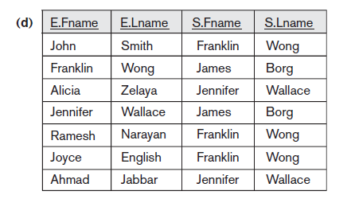

Slide 31
ALIASES (cont.)
  Aliasing can also be used in any SQL query for convenience
  Can also use the AS keyword to specify aliases
  Q8: SELECT E.FNAME, E.LNAME, S.FNAME, S.LNAME
  FROM EMPLOYEE AS E, EMPLOYEE AS S
  WHERE E.SUPERSSN=S.SSN
We can think of E and S as two different copies of EMPLOYEE.
E represents employees in role of supervisees
S represents employees in role of supervisors.
Slide 8-<number>

Slide 32
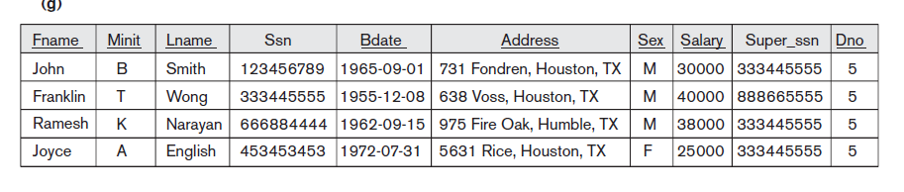
USE OF *
To retrieve all the attribute values of the selected tuples, a * is used, which stands for all the attributes
Examples:
Q1C: SELECT *
FROM EMPLOYEE
WHERE DNO=5
Slide 8-<number>

Slide 33
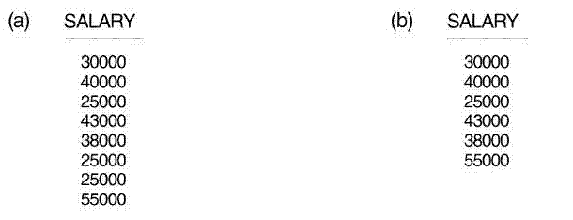
DISTINCT
SQL does not treat a relation as a set; duplicate tuples can appear
To eliminate duplicate tuples in a query result, the keyword DISTINCT is used
Q11: SELECT SALARY
FROM EMPLOYEE
Q11A: SELECT DISTINCT SALARY
FROM EMPLOYEE
Slide 8-<number>

Slide 34
AGGREGATE FUNCTIONS
COUNT, SUM, MAX, MIN, and AVG
Query 15: Find the maximum salary, the minimum salary, and the average salary among all employees.
Q15: SELECT MAX(SALARY), MIN(SALARY), AVG(SALARY) FROM EMPLOYEE
  Some SQL implementations may not allow more than one function in the SELECT-clause
Slide 8-<number>

Slide 35
AGGREGATE FUNCTIONS (cont.)
Query 16: Find the maximum salary, the minimum salary, and the average salary among employees who work for the 'Research' department.
Q16: SELECT MAX(SALARY), MIN(SALARY), AVG(SALARY)
FROM EMPLOYEE, DEPARTMENT
WHERE DNO=DNUMBER AND DNAME='Research'
Slide 8-<number>

Slide 36
AGGREGATE FUNCTIONS (cont.)
Queries 17 and 18: Retrieve the total number of employees in the company (Q17), and the number of employees in the 'Research' department (Q18).
Q17: SELECT COUNT (*)
FROM EMPLOYEE
Q18: SELECT COUNT (*)
FROM EMPLOYEE, DEPARTMENT
WHERE DNO=DNUMBER AND DNAME='Research’
Slide 8-<number>

Slide 37
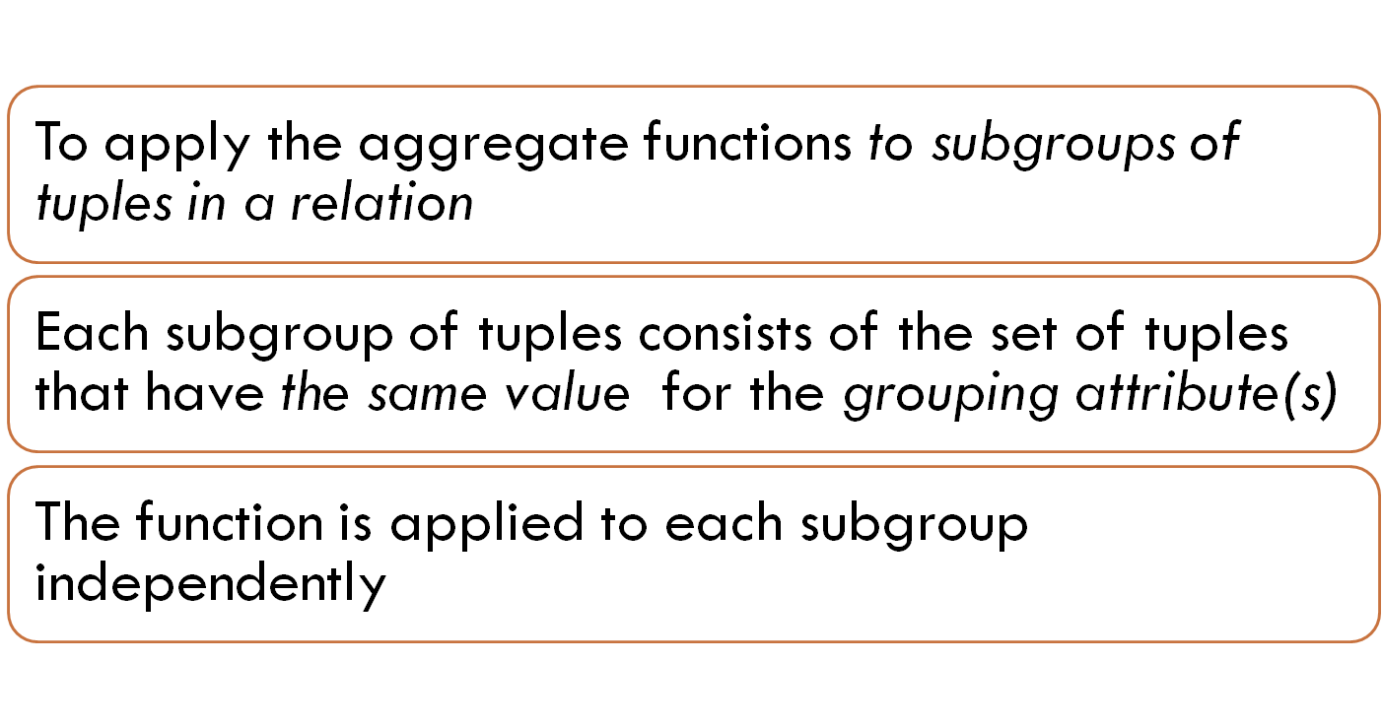
GROUPING
Slide 8-<number>

Slide 38
GROUPING (cont.)
Query 20: For each department, retrieve the department number, the number of employees in the department, and their average salary.
Q20: SELECT DNO, COUNT (*), AVG (SALARY)
FROM EMPLOYEE
GROUP BY DNO
  In Q20, the EMPLOYEE tuples are divided into groups--each group having the same value for the grouping attribute DNO
  The COUNT and AVG functions are applied to each such group of tuples separately
  The SELECT-clause includes only the grouping attribute and the functions to be applied on each group of tuples
  A join condition can be used in conjunction with grouping
Slide 8-<number>

Slide 39
GROUPING (cont.)
Query 21: For each project, retrieve the project number, project name, and the number of employees who work on that project
Q21: SELECT PNUMBER, PNAME, COUNT (*)
FROM PROJECT, WORKS_ON
WHERE PNUMBER=PNO
GROUP BY PNUMBER, PNAME
In this case, the grouping and functions are applied after the joining of the two relations
Slide 8-<number>

Slide 40
THE HAVING-CLAUSE
To retrieve the values of functions for only those groups that satisfy certain conditions
The HAVING-clause is used for specifying a selection condition on groups (rather than on individual tuples)
Slide 8-<number>

Slide 41
THE HAVING-CLAUSE (cont.)
Query 22: For each project on which more than two employees work , retrieve the project number, project name, and the number of employees who work on that project.
Q22: SELECT PNUMBER, PNAME, COUNT (*)
FROM PROJECT, WORKS_ON
WHERE PNUMBER=PNO
GROUP BY PNUMBER, PNAME
HAVING COUNT (*) > 2
Join condition
Groups
count
Slide 8-<number>

Slide 42
SUBSTRING COMPARISON
The LIKE comparison operator is used to compare partial strings
Two reserved characters are used:
'%‘ or '*‘ replace an arbitrary number of characters
'_' replaces a single arbitrary character
Slide 8-<number>

Slide 43
SUBSTRING COMPARISON (cont.)
Query 25: Retrieve all employees whose address is in Houston, Texas. Here, the value of the ADDRESS attribute must contain the substring 'Houston,TX'.
Q25: SELECT FNAME, LNAME
FROM EMPLOYEE
WHERE ADDRESS LIKE '%Houston,TX%’
Slide 8-<number>

Slide 44
SUBSTRING COMPARISON (cont.)
Query 26: Retrieve all employees who were born during the 1950s.
Q26: SELECT FNAME, LNAME
FROM EMPLOYEE
WHERE BDATE LIKE '_______5_’
The LIKE operator allows us to get around the fact that each value is considered atomic and indivisible; hence, in SQL, character string attribute values are not atomic
Here, '5' must be the 8th character of the string (according to our format for date), so the BDATE value is '_______5_', with each underscore as a place holder for a single arbitrary character.
Slide 8-<number>

Slide 45
ARITHMETIC OPERATIONS
The standard arithmetic operators '+', '-'. '*', and '/' can be applied to numeric values in an SQL query result
Query 27: Show the effect of giving all employees who work on the 'ProductX' project a 10% raise.
Q27: SELECT FNAME, LNAME, 1.1*SALARY
FROM EMPLOYEE, WORKS_ON, PROJECT
WHERE SSN=ESSN AND PNO=PNUMBER AND PNAME='ProductX’
Slide 8-<number>

Slide 46
ORDER BY
The ORDER BY clause is used to sort the tuples in a query result based on the values of some attribute(s)
Query 28: Retrieve a list of employees and the projects each works in, ordered by the employee's department, and within each department ordered alphabetically by employee last name.
Q28: SELECT DNAME, LNAME, FNAME, PNAME
FROM DEPARTMENT, EMPLOYEE, WORKS_ON, PROJECT
WHERE DNUMBER=DNO AND SSN=ESSN AND PNO=PNUMBER
ORDER BY DNAME, LNAME
Slide 8-<number>

Slide 47
ORDER BY (cont.)
The default order is in ascending order of values
We can specify the keyword DESC if we want a descending order;
The keyword ASC can be used to explicitly specify ascending order, even though it is the default
Slide 8-<number>

Slide 48
SET OPERATIONS
UNION
Set difference (MINUS)
Intersection (INTERSECT)
The resulting relations of these set operations are sets of tuples;
Important points:
Duplicate tuples are eliminated from the result
The set operations apply only to compatible relations( i.e the two relations must have the same attributes and the attributes must appear in the same order)
Slide 8-<number>

Slide 49
SET OPERATIONS (cont.)
Query 4: Make a list of all project numbers for projects that involve an employee whose last name is 'Smith' as a worker or as a manager of the department that controls the project.
(SELECT PNAME
FROM PROJECT, DEPARTMENT, EMPLOYEE
WHERE DNUM=DNUMBER AND MGRSSN=SSN AND LNAME='Smith')
UNION
(SELECT PNAME
FROM PROJECT, WORKS_ON, EMPLOYEE
WHERE PNUMBER=PNO AND ESSN=SSN AND LNAME='Smith')
Slide 8-<number>

Slide 50
NESTING OF QUERIES
A complete SELECT query, called a nested query , can be specified within the WHERE-clause of another query, called the outer query
Query 1: Retrieve the name and address of all employees who work for the 'Research' department.
Q1: SELECT FNAME, LNAME, ADDRESS
FROM EMPLOYEE
WHERE DNO IN (SELECT DNUMBER
FROM DEPARTMENT
WHERE DNAME='Research' )
The outer query select an EMPLOYEE tuple if its DNO value is in the result of nested query
The comparison operator IN compares a value v with a set (or multi-set) of values V, and evaluates to TRUE if v is one of the elements in V
The nested query selects the number of the 'Research' department
Slide 8-<number>

Slide 51
CORRELATED NESTED QUERIES
If a condition in the WHERE-clause of a nested query references an attribute of a relation declared in the outer query
Query 12: Retrieve the name of each employee who has a dependent with the same first name as the employee.
Q12: SELECT E.FNAME, E.LNAME
FROM EMPLOYEE AS E
WHERE E.SSN IN (SELECT ESSN
FROM DEPENDENT
WHERE ESSN=E.SSN AND
E.FNAME=DEPENDENT_NAME)
Q12A:SELECT E.FNAME, E.LNAME
FROM EMPLOYEE E, DEPENDENT D
WHERE E.SSN=D.ESSN AND E.FNAME=D.DEPENDENT_NAME
Same query-
Two diff ways
Slide 8-<number>

Slide 52
THE EXISTS FUNCTION
EXISTS is used to check whether the result of a correlated nested query is empty (contains no tuples) or not
Slide 8-<number>

Slide 53
THE EXISTS FUNCTION (cont.)
Query 12: Retrieve the name of each employee who has a dependent with the same first name as the employee.
Q12B: SELECT FNAME, LNAME
FROM EMPLOYEE
WHERE EXISTS (SELECT *
FROM DEPENDENT
WHERE SSN=ESSN AND FNAME=DEPENDENT_NAME)
Slide 8-<number>

Slide 54
THE EXISTS FUNCTION (cont.)
Query 6: Retrieve the names of employees who have no dependents.
Q6:
SELECT FNAME, LNAME
FROM EMPLOYEE
WHERE NOT EXISTS ( SELECT *
FROM DEPENDENT
WHERE SSN=ESSN)
Slide 8-<number>

Slide 55
EXPLICIT SETS
It is also possible to use an explicit (enumerated) set of values
Query 13: Retrieve the social security numbers of all employees who work on project number 1, 2, or 3.
Q13: SELECT DISTINCT ESSN
FROM WORKS_ON
WHERE PNO IN (1, 2, 3)
Slide 8-<number>

Slide 56
NULLS IN SQL QUERIES
SQL allows queries that check if a value is NULL
- (missing / undefined /not applicable)
SQL uses IS or IS NOT to compare NULLs because it considers each NULL value distinct from other NULL values, so equality comparison is not appropriate .
Query 14: Retrieve the names of all employees who do not have supervisors.
Q14: SELECT FNAME, LNAME
FROM EMPLOYEE
WHERE SUPERSSN IS NULL
Note: If a join condition is specified, tuples with NULL values for the join attributes are not included in the result
Slide 8-<number>

Slide 57
Joins in SQL
SQL joins are used to query data from two or more tables, based on a relationship between certain columns in these tables.

Slide 58
Joined Relations Feature in SQL2
The SQL Joins clause is used to combine records from two or more tables in a database.
A JOIN is a means for combining fields from two tables by using values common to each.
Different types of joins
  JOIN /INNER JOIN
  LEFT OUTER JOIN
  RIGHT OUTER JOIN
  FULL OUTER
  NATURAL JOIN
  CROSS JOIN
Slide 8-<number>

Slide 59
Different SQL Joins
JOIN: Return rows when there is at least one match in both tables
LEFT JOIN: Return all rows from the left table, even if there are no matches in the right table
RIGHT JOIN: Return all rows from the right table, even if there are no matches in the left table
FULL JOIN: Return rows when there is a match in one of the tables

Slide 60
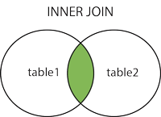
Join/Inner Join/Equi Join
The INNER JOIN creates a new result table by combining
column values of two tables (table1 and table2) based
upon the join-predicate.
Q1: SELECT FNAME, LNAME, ADDRESS
FROM (EMPLOYEE JOIN DEPARTMENT
ON DNUMBER=DNO)
WHERE DNAME='Research’

Slide 61
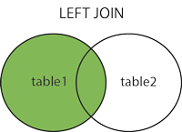
LEFT JOIN
The SQL LEFT JOIN returns all rows from the left table, even if there are no matches in the right table.
This means that if the ON clause matches 0 (zero) records in right table, the join will still return a row in the result, but with NULL in each column from right table.
This means that a left join returns all the values from the left table, plus matched values from the right table or NULL in case of no matching join predicate.
Q8: SELECT E.FNAME, E.LNAME, S.FNAME, S.LNAME
FROM (EMPLOYEE E LEFT OUTER JOIN EMPLOYEES
ON E.SUPERSSN=S.SSN)
Slide 8-<number>

Slide 62
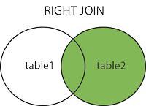
Right Join
Right Join – Similar to left join

Slide 63
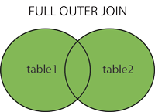
Full outer Join/Full Join
The SQL FULL JOIN combines the results of both left and right outer joins.
The joined table will contain all records from both tables, and fill in NULLs for missing matches on either side.

Slide 64
Natural Join
The SQL NATURAL JOIN is a type of EQUI JOIN and is structured in such a way that, columns with same name of associate tables will appear once only.
  The associated tables have one or more pairs of identically named columns.
  The columns must be the same data type.
  Don’t use ON clause in a natural join.
Q1: SELECT FNAME, LNAME, ADDRESS
FROM (EMPLOYEE NATURAL JOIN DEPARTMENT
AS DEPT(DNAME, DNO, MSSN, MSDATE)
WHERE DNAME='Research’
Slide 8-<number>

Slide 65
CARTESIAN JOIN/ CROSS JOIN
The CARTESIAN JOIN or CROSS JOIN returns the Cartesian product of the sets of records from the two or more joined tables.

Slide 66
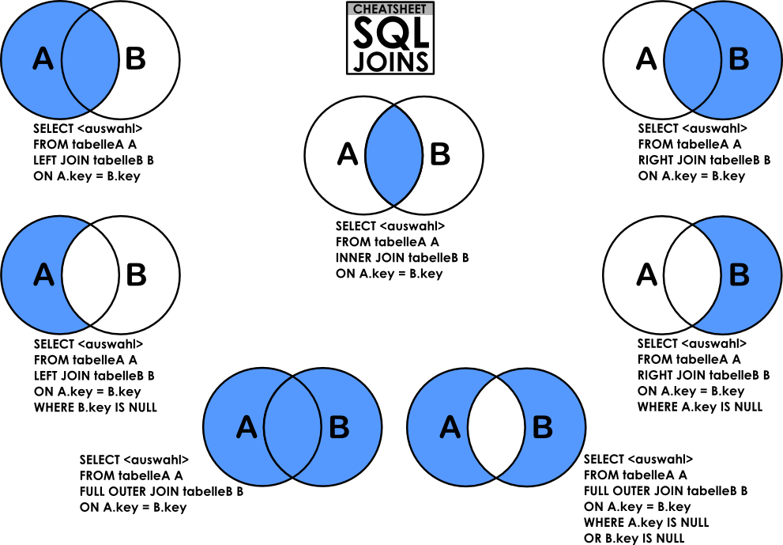

Slide 67
Summary of SQL Queries
A query in SQL can consist of up to six clauses, but only the first two, SELECT and FROM, are mandatory. The clauses are specified in the following order:
SELECT <attribute list>
FROM <table list>
[WHERE <condition>]
[GROUP BY <grouping attribute(s)>]
[HAVING <group condition>]
[ORDER BY <attribute list>]
Slide 8-<number>

Slide 68
Summary of SQL Queries (cont.)
The SELECT-clause lists the attributes or functions to be retrieved
The FROM-clause specifies all relations (or aliases) needed in the query but not those needed in nested queries
The WHERE-clause specifies the conditions for selection and join of tuples from the relations specified in the FROM-clause
GROUP BY specifies grouping attributes
HAVING specifies a condition for selection of groups
ORDER BY specifies an order for displaying the result of a query
A query is evaluated by first applying the WHERE-clause, then GROUP BY and HAVING, and finally the SELECT-clause
Slide 8-<number>

Slide 69
Specifying Updates in SQL
There are three SQL commands to modify the database; INSERT, DELETE, and UPDATE
Slide 8-<number>

Slide 70
INSERT
Used to add one or more tuples to a relation
Attribute values should be listed in the same order as the attributes were specified in the CREATE TABLE command
Slide 8-<number>

Slide 71
INSERT (cont.)
Example:
U1: INSERT INTO EMPLOYEE VALUES ('Richard','K','Marini', '653298653', '30-DEC-52‘,'98 Oak Forest,Katy,TX', 'M', 7000,'987654321', 4 )
An alternate form of INSERT specifies explicitly the attribute names that correspond to the values in the new tuple
Example: Insert a tuple for a new EMPLOYEE for whom we only know the FNAME, LNAME, and SSN attributes.
U1A: INSERT INTO EMPLOYEE (FNAME, LNAME, SSN)
VALUES ('Richard', 'Marini', '653298653')
Slide 8-<number>

Slide 72
INSERT (cont.)
Note: Only the constraints specified in the DDL commands are automatically enforced by the DBMS when updates are applied to the database
Another variation of INSERT allows insertion of multiple tuples resulting from a query into a relation
Slide 8-<number>

Slide 73
INSERT (cont.)
  Example: Suppose we want to create a temporary table that has the name, number of employees, and total salaries for each department. A table DEPTS_INFO is created by U3A, and is loaded with the summary information retrieved from the database by the query in U3B.
  U3A: CREATE TABLE DEPTS_INFO
  (DEPT_NAME VARCHAR(10),
  NO_OF_EMPS INTEGER,
  TOTAL_SAL INTEGER);
  U3B: INSERT INTO DEPTS_INFO (DEPT_NAME, NO_OF_EMPS, TOTAL_SAL)
  SELECT DNAME, COUNT (*), SUM (SALARY)
  FROM DEPARTMENT, EMPLOYEE
  WHERE DNUMBER=DNO
  GROUP BY DNAME ;
Slide 8-<number>

Slide 74
INSERT (cont.)
Note: The DEPTS_INFO table may not be up-to-date if we change the tuples in either the DEPARTMENT or the EMPLOYEE relations after issuing U3B. We have to create a view (see later) to keep such a table up to date.
Slide 8-<number>

Slide 75
DELETE
Removes tuples from a relation
Includes a WHERE-clause to select the tuples to be deleted
Tuples are deleted from only one table at a time (unless CASCADE is specified on a referential integrity constraint)
A missing WHERE-clause specifies that all tuples in the relation are to be deleted; the table then becomes an empty table
The number of tuples deleted depends on the number of tuples in the relation that satisfy the WHERE-clause
Referential integrity should be enforced
Slide 8-<number>

Slide 76
DELETE (cont.)
U4A: DELETE FROM EMPLOYEE
WHERE LNAME='Brown’
U4B: DELETE FROM EMPLOYEE
WHERE SSN='123456789’
U4C: DELETE FROM EMPLOYEE
WHERE DNO IN (SELECT DNUMBER
FROM DEPARTMENT
WHERE DNAME='Research')
U4D: DELETE FROM EMPLOYEE
Slide 8-<number>

Slide 77
UPDATE
Used to modify attribute values of one or more selected tuples
A WHERE-clause selects the tuples to be modified
An additional SET-clause specifies the attributes to be modified and their new values
Each command modifies tuples in the same relation
Referential integrity should be enforced
Slide 8-<number>

Slide 78
UPDATE (cont.)
Example: Change the location and controlling department number of project number 10 to 'Bellaire' and 5, respectively.
U5: UPDATE PROJECT
SET PLOCATION = 'Bellaire', DNUM = 5
WHERE PNUMBER=10
Slide 8-<number>

Slide 79
UPDATE (cont.)
Example: Give all employees in the 'Research' department a 10% raise in salary.
U6: UPDATE EMPLOYEE
SET SALARY = SALARY *1.1
WHERE DNO IN (SELECT DNUMBER
FROM DEPARTMENT
WHERE DNAME='Research')
In this request, the modified SALARY value depends on the original SALARY value in each tuple
The reference to the SALARY attribute on the right of = refers to the old SALARY value before modification
The reference to the SALARY attribute on the left of = refers to the new SALARY value after modification
Slide 8-<number>

Slide 80
Thankyou

